Slide 1
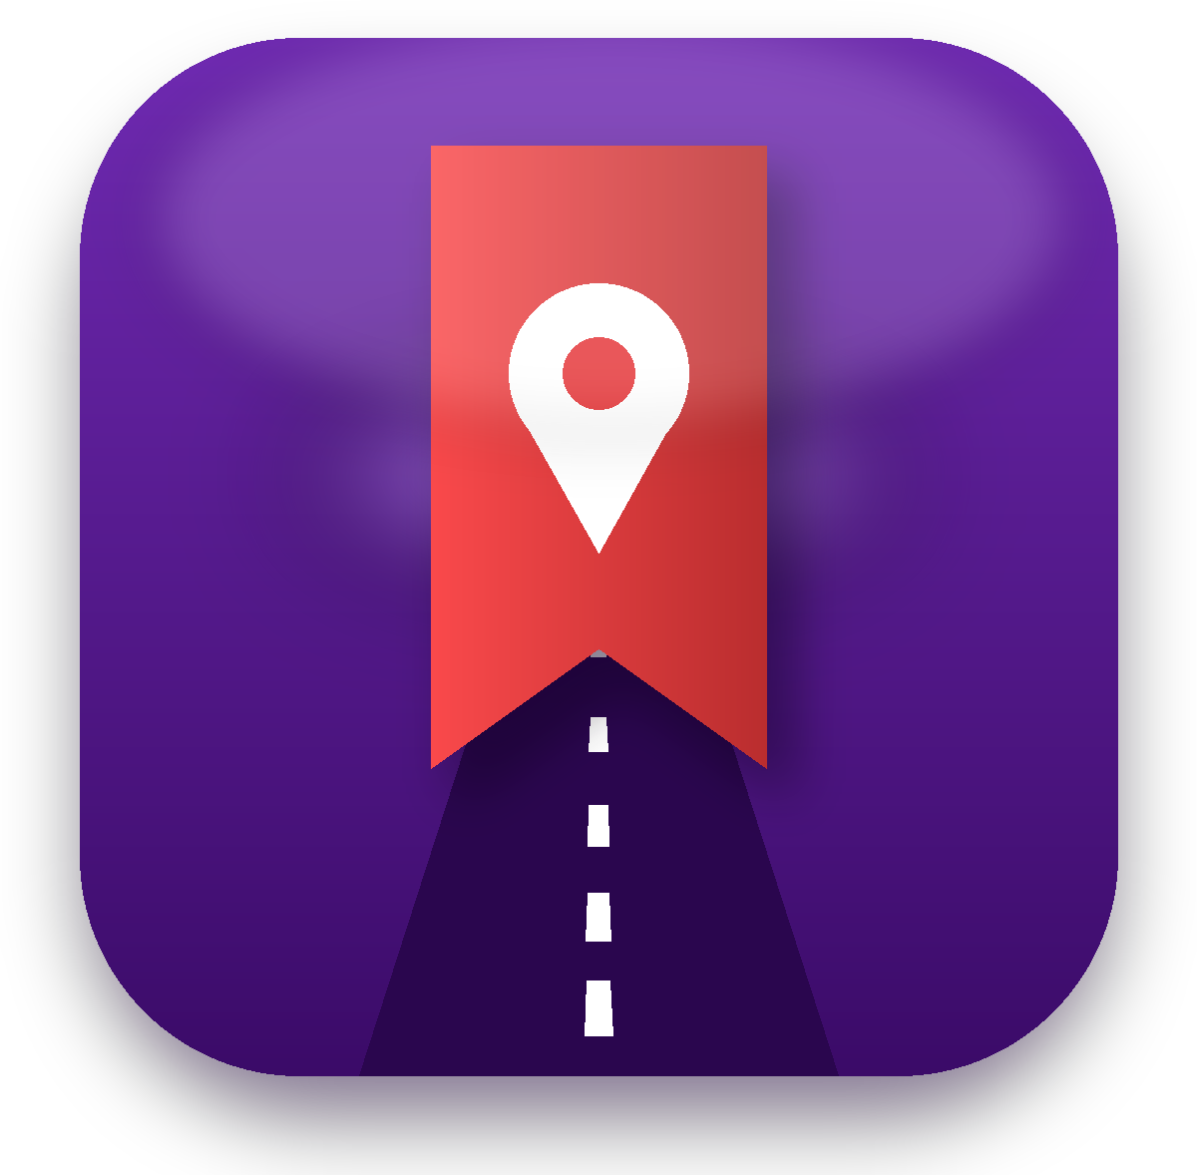
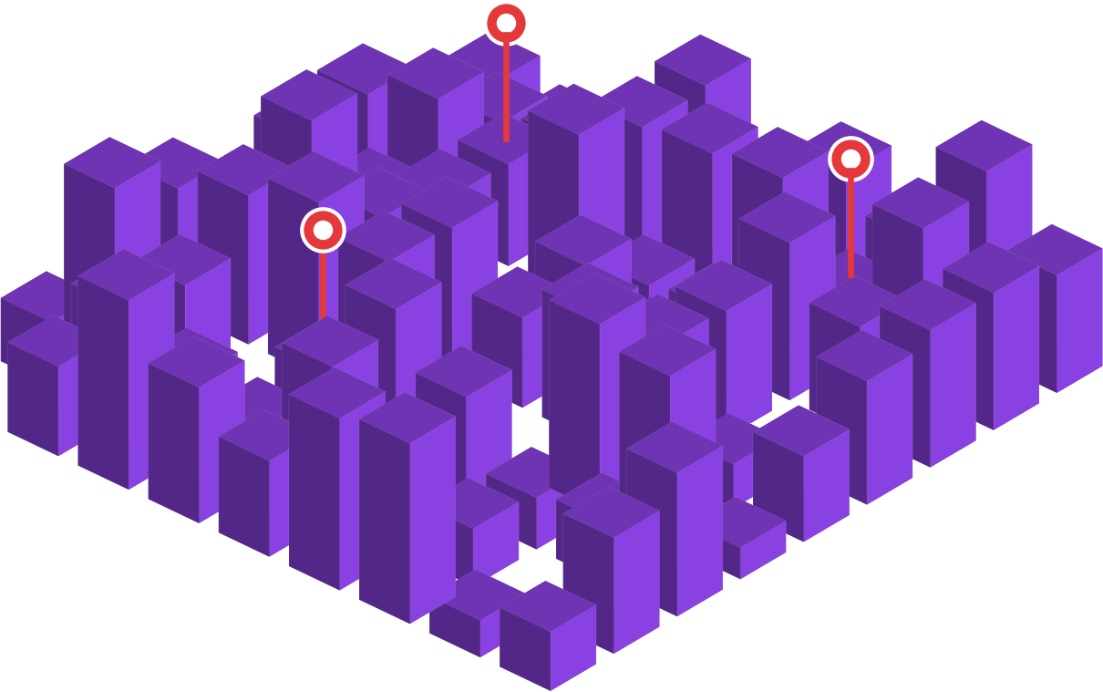
Turn Instagram saves into shoppers.
Spotted reminds people who saved your shop when they walk nearby, and shows you who bought.
Start →

Slide 2

STEP 1 OF 4
Someone sees your shop in a reel.
A bag, a perfume, an outfit. They love it.

Slide 3

STEP 2 OF 4
They tap save… and forget.
Saved posts get lost. The visit never happens.

Slide 4

STEP 3 OF 4
They walk past your shop. Spotted taps their phone: "You're close!"
A gentle reminder, only for shops they saved.

Slide 5

STEP 4 OF 4
They come in, buy, and you scan. Green star!
You see who saved, who visited and who bought.
See how it helps you →

Slide 6






What's inside
Tap any card. The Menu button on every slide brings you back.
Why Spotted
Compared with ads →
The 3 stars
Saved, visited, bought →
Customer perks
10 reasons they come back →
Pick your plan
AED 99, 199 or 299 →
Payments
2 months free, then prepaid →
Questions
16 answers →

Slide 7

Know who actually walked in
Menu
Paid ads
Spotted
You pay for views and clicks
You never know who came to the shop
The money stops, the results stop
One flat plan from AED 99
Reminds people who already want you
Every visit and purchase counted
Loyalty cards bring them back
Spotted works alongside your Instagram, not instead of it.

Slide 8



3 stars show what really happened
Menu
Yellow star
Purple star
Green star
Saved your place but hasn't visited yet
Visited, but didn't buy anything
Visited and bought something
How: Purple: the customer scans the QR sticker at your door. Green: your staff scan their coupon or loyalty card at the till. Creators only see yellow and green: any visit counts as green for them.

Slide 9







Why customers love it
Menu
Loyalty card
Spotted-only offers
Nearby reminders
New-collection alerts
Early sale access
Buy 5 times, get 10% off the 6th
Free gift wrap, free samples
When you pass a shop you saved
From shops you saved
24-hour head start on Eid and White Friday
Birthday treat
Budget search
Save products
Spotted Passport
Invite 3 friends
From shops you've bought from
"Shoes under AED 200 near me"
Save the bag from a reel, get reminded near the shop
Collect stamps at different shops, enter a monthly prize draw
You all get a reward

Slide 10


Pick the plan that suits you
Menu
Every shop chooses. Start small and move up anytime.
Shop Starter
AED 99/month
8 benefits · 1 active offer
Great for small local shops →
Shop Plus
AED 199/month
6 more benefits · 3 active offers
Great for boutiques, perfume and beauty →
Shop Pro
AED 299/month
9 more benefits · Unlimited offers
Great for big stores and chains →
Clothing, abayas, shoes, bags, perfume, cosmetics, jewellery, watches, gifts, phones, electronics, home décor, toys, books, opticians, flowers, sports and more.

Slide 11
Shop Starter
Menu
8 BENEFITS IN TOTAL
Includes:
Shop page: photos, products, prices, hours
Nearby reminders to people who saved you
1 active offer
Basic loyalty card (one reward)
Visit and purchase scanning
Basic monthly report
Listed in category filters
Directions, call and WhatsApp buttons
Great for small local shops. Any shop can pick it.
AED 99 /month
1 active offer. Or AED 1,089 a year (pay 11 months, get 12).
First 2 months free
Example: A tailor: free hemming on the 5th visit. Owner sees 90 saves, 30 visits and 18 purchases a month.
← All plans
Start free →

Slide 12
Shop Plus
Menu
14 BENEFITS IN TOTAL
Everything in Starter, plus:
Up to 3 active offers
Advanced loyalty card (several rewards)
New-collection alerts
Quiet-hours deals
Birthday treats
Creator picks (see which creators bring buyers)
Great for boutiques, perfume and beauty. Any shop can pick it.
AED 199 /month
3 active offers. Or AED 2,189 a year (pay 11 months, get 12).
First 2 months free
Example: A perfume shop: free sample every visit, a mini bottle on the 5th purchase, 15% off in your birthday month, and an alert when the new oud collection lands.
← All plans
Start free →

Slide 13
Shop Pro
Menu
23 BENEFITS IN TOTAL
Everything in Plus, plus:
Unlimited offers
Featured at the top of area search
Star reviews from real buyers
Monthly spot in the WhatsApp update
Products in budget search
Sale alerts (Eid, White Friday)
Detailed report: busy times, repeat buyers
Up to 3 branches, one dashboard (+AED 79 per extra)
Priority support
Great for big stores and chains. Any shop can pick it.
AED 299 /month
Unlimited offers. Or AED 3,289 a year (pay 11 months, get 12).
First 2 months free
Example: A shoe chain with 3 mall stores: a different offer per branch, Eid sale alert 24 hours early for Spotted users, featured when people search "shoes near me".
← All plans
Start free →

Slide 14


What we need from you
Menu
Your products
Your top 10 products with prices, or your catalogue
Your offer
A free gift wrap, sample, % off or loyalty reward
Photos or video
Of your shop and best products
Collection & sale dates
When new stock lands and when sales run
A short description
Who you are and your category (clothing, perfume...)

Slide 15

Simple payments, no surprises
Menu
2 months free
Then prepaid
Payment issue?
After 60 days
Try everything first
Monthly, or yearly: pay 11 months, get 12
Fully active for 60 more days
Profile hidden. Content kept safe
After 60 days: your shop is hidden from customers and you can't see your content or receive stars, but everything is kept safe. Customers who saved you can still see your location. Pay anytime and it all comes back.

Slide 16
Your questions, answered
Menu
Tap a topic to see the answers.
4
4
4
Getting started
Which shops can join? →
Stars and scanning
What do the 3 stars mean? →
Offers
How many offers can I run? →
4
Payments
Is there a free trial? →

Slide 17
Getting started
Menu
Which shops can join?
Which plan do I get?
Any shop: Clothing, abayas, shoes, bags, perfume, cosmetics, jewellery, watches, gifts, phones, electronics, home décor, toys, books, opticians, flowers, sports and more.
You choose. Start with Starter and move up anytime.
How long does setup take?
What equipment do I need?
About a week. We build your page with you, free.
Just a phone or tablet to scan, and our QR sticker for your door.
← All questions
Next topic →

Slide 18
Stars and scanning
Menu
What do the 3 stars mean?
How is a purchase counted?
Yellow: saved, not visited. Purple: visited, bought nothing. Green: visited and bought.
Your staff scan the customer's coupon or loyalty card at the till.
How is a visit counted?
What do creators see?
The customer scans the QR sticker at your door.
Only yellow and green. Any visit they bring counts as green.
← All questions
Next topic →

Slide 19
Offers
Menu
How many offers can I run?
Who pays for the offer?
Starter 1, Plus 3, Pro unlimited.
You choose it, so pick something low-cost like gift wrap or samples.
Can I change my offer?
What are sale alerts?
Yes, anytime from your dashboard.
Pro shops alert people who saved them 24 hours before a sale.
← All questions
Next topic →

Slide 20
Payments
Menu
Is there a free trial?
Is yearly cheaper?
Yes. 2 months free, then prepaid.
Yes. Pay 11 months, get 12.
What if a payment fails?
Can I cancel?
Fully active for 60 days, then hidden until paid. Content kept safe.
Yes. A free listing is always available.
← All questions

Slide 21




Be a founding shop
Menu
Founding price locked for 12 months
Featured in launch week
"Founding partner" badge in the app
We set up your page with you, free
Limited to the first 20 shops in Khalifa City.

Slide 22

Start your 2 free months today
1
Pick your plan
2
Send your products, offer and photos
3
We set up your page. Shoppers start coming
WhatsApp +971 50 873 3160
Back to menu

